Slide 1
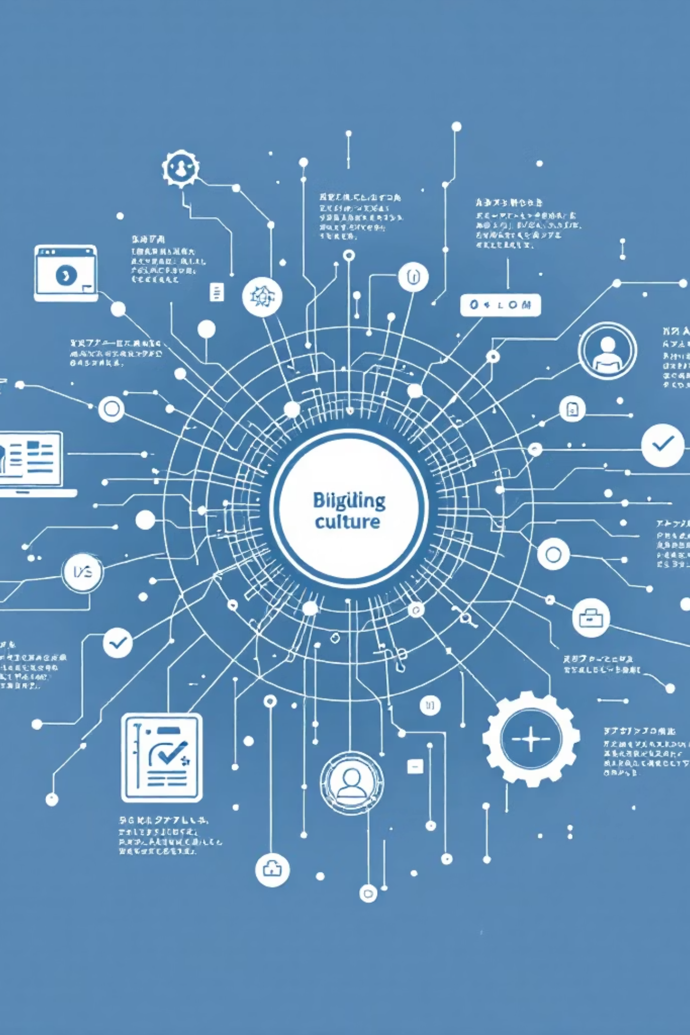
Course Module - 3
Building Digital Culture
Course: Organizational Culture & Change Management
Core References: Sinha (2019); Sengupta (2018); Nilakant & Ramnarayan (2024); Singh (2024); Ghosh & Gupta (2019); Cameron & Quinn (2019); Cummings & Worley (2018); Strohmeier & Piazza (2020); Scott & Jaffe (2017)

Slide 2
MODULE 3: BUILDING DIGITAL CULTURE (12 HOURS)
Module | Session | Topic | Readings / References | Pedagogy / Activity Planned | CO | Component | Mode of Delivery
M3 | 25 | Digital Transformation & Culture | Strohmeier & Piazza (2020) | Conceptual Lecture | CO3 | LECTURE | Synchronous
M3 | 26 | Role of Technology in Organizational Culture | Case Examples | Lecture + Discussion | CO3 | LECTURE | Synchronous
M3 | 27 | Opportunities & Challenges of Digital Transformation | HBR Digital Cases | Lecture + Case Study | CO3 | LECTURE | Synchronous
M3 | 28 | Strategies for Building a Strong Digital Culture | McKinsey Global Reports | Lecture + Q&A | CO3 | LECTURE | Synchronous
M3 | 29 | Cultural Barriers to Change in the Digital Era | Peer-Reviewed Research Papers | Class Debate | CO3 | LECTURE | Synchronous
M3 | 30 | Impact of Artificial Intelligence on Work Culture | AI & Work Research (MIT, Gartner) | Lecture + Live Industry Examples | CO3 | LECTURE | Synchronous

Slide 3
Module | Session | Topic | Readings / References | Pedagogy / Activity Planned | CO | Component | Mode of Delivery
M3 | 31 | Advanced Stakeholder Engagement Techniques in Digital Settings | Case Studies (Accenture, Deloitte) | Lecture + Tools Application | CO3 | LECTURE | Synchronous
M3 | 32 | Cross-Functional Collaboration in Digital Change Initiatives | Harvard Change Toolkit | Lecture + Discussion | CO3 | LECTURE | Synchronous
M3 | 33 | Cultural Audits, Mapping, and Gap Analysis | Cameron & Quinn – Diagnosing and Changing Organizational Culture | Lecture + Framework Application | CO3 | LECTURE | Synchronous
M3 | 34 | Experiential: Digital Culture Case Hackathon | Live Organizational Cases | Group Hackathon | CO3 | EXPERIENTIAL | Synchronous
M3 | 35 | Experiential: Stakeholder Mapping & Engagement Workshop | Simulation Toolkit | Interactive Workshop | CO3 | EXPERIENTIAL | Synchronous
M3 | 36 | Experiential: Debate on AI’s Impact on Organizational Culture | Current Research Articles | Structured Debate + Reflection | CO3 | EXPERIENTIAL | Synchronous

Slide 4



Understanding Digital Transformation
Digital transformation integrates digital technology into all business areas, fundamentally reshaping how organizations operate and deliver value (Strohmeier & Piazza, 2020).
This requires a profound mindset shift and cultural evolution, impacting leadership, collaboration, and learning across the organization (Nilakant & Ramnarayan, 2024).
Strategic Mindset
Moving beyond technology to embrace cultural change and innovation
Operational Agility
Rethinking roles, structures, and values to remain adaptive (Cummings & Worley, 2018)

Slide 5
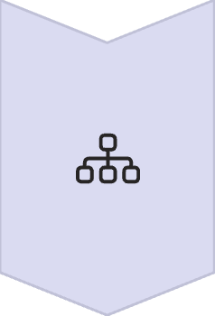



Impact of Digital Transformation on Organizational Culture
Digital transformation catalyzes fundamental shifts in organizational structure and behavior, reshaping the very fabric of workplace culture.
Structural evolution
Transition from hierarchical pyramids to networked, collaborative structures that emphasize agility and cross-functional integration (Cameron & Quinn, 2019)
Decision-making paradigm
Encourages openness, data-driven decision-making, and continuous experimentation rather than intuition-based choices (Sengupta, 2018)
Behavioral transformation
Promotes learning-oriented, flexible, and cross-functional behaviors that transcend traditional departmental boundaries
Cultural challenge
Confronts traditional organizational traits such as power distance and collectivism, particularly relevant in indian organizational contexts (sinha, 2019)

Slide 6




The Role of Technology in Shaping Culture
Technology serves as a cultural accelerator, fundamentally transforming how organizations operate, communicate, and create value. Digital platforms redefine communication patterns and collaboration norms, creating new possibilities for organizational interaction (Scott & Jaffe, 2017).
Transparency & Accountability
Evidence-based culture
Digital systems reinforce openness and speed, making organizational processes more visible and accountable to all stakeholders
Artificial Intelligence and analytics transform knowledge-sharing and decision-making into more evidence-based practices (Strohmeier & Piazza, 2020)
Dual-Edged Impact
Technology tools can simultaneously enable empowerment through access and intensify surveillance, fundamentally altering workplace trust dynamics

Slide 7






Opportunities in Digital Transformation
Despite its challenges, digital transformation opens remarkable possibilities for organizational growth, innovation, and cultural evolution.
Stakeholder Connectedness
Digital tools dramatically improve transparency and engagement across all organizational stakeholder groups
Continuous Learning
Adaptive Innovation
Encourages ongoing skill development through online platforms and AI-based training systems accessible to all employees
Enables organizations to build adaptive and innovative cultures that respond rapidly to market changes (Cummings & Worley, 2018)
Shared Digital Purpose
Global Collaboration
Builds a sense of unified cultural identity centered around digital innovation and transformation goals
Facilitates seamless international teamwork and democratized decision-making across geographical boundaries

Slide 8
Challenges of Digital Transformation
Organizations face multifaceted obstacles as they navigate the complex journey of digital transformation, requiring thoughtful strategies to address human, technological, and cultural barriers.
Resistance to Change
Digital Divide
Cultural Inertia
Employees experience fear of redundancy and skill obsolescence, creating psychological barriers to adoption (Sengupta, 2018)
Uneven technological access and literacy levels create inequitable participation in digital initiatives (Singh, 2024)
Legacy values and established behavioral patterns resist new digital norms and ways of working (Sinha, 2019)
Leadership Gaps
Cyber-Ethics Concerns
Inadequate digital mindset and capabilities at senior leadership levels hinder transformation efforts (Nilakant & Ramnarayan, 2024)
Complex issues surrounding data privacy, employee autonomy, and work–life boundaries demand careful navigation

Slide 9
Strategies to Build a Strong Culture in a Digital Environment
Successful digital culture transformation requires deliberate, multi-faceted strategies that address leadership, structure, capability, and engagement simultaneously.
01
02
Leadership Role Modeling
Cultural Alignment
Senior leaders must visibly demonstrate digital behaviors, openness to innovation, and willingness to experiment (Nilakant & Ramnarayan, 2024)
Ensure organizational mission, structure, and incentive systems align with digital values and desired behaviors (Cameron & Quinn, 2019)
03
04
Strategic Empowerment
Digital Literacy Programs
Decentralize decision-making authority and actively promote experimentation and calculated risk-taking at all levels
Implement comprehensive training initiatives that build digital capabilities across all employee levels and functions
05
06
Storytelling & Symbols
Continuous Feedback Loops
Celebrate and amplify stories of digital innovation and collaboration to reinforce desired cultural values (Ghosh & Gupta, 2019)
Establish ongoing pulse surveys and digital engagement analytics to monitor cultural health and adaptation progress

Slide 10
Cultural Barriers to Change
Organizations must recognize and address deeply embedded cultural obstacles that can derail even well-planned transformation initiatives.
Traditionalism & Hierarchy
Deep-rooted traditional values and rigid status hierarchies create resistance to flatter, more collaborative digital structures (Sinha, 2019)
Values-Practice Misalignment
Significant gaps between espoused values promoting innovation and enacted practices favoring risk avoidance undermine transformation efforts
Psychological Safety Deficit
Absence of safe environments for experimentation and failure prevents the learning cycles essential for digital adaptation (Scott & Jaffe, 2017)
Communication Breakdown
Poor change communication channels create confusion, rumors, and resistance among employee populations (Sengupta, 2018)
Short-Term Focus
Overemphasis on immediate KPIs versus long-term culture building prevents sustainable transformation (Cummings & Worley, 2018)

Slide 11

Impact of AI on Organizational Culture
Artificial Intelligence represents a transformative force that fundamentally reshapes organizational culture, introducing both opportunities and ethical complexities that demand careful consideration.
Cultural Transformations
Ethical Tensions
Decision-Making Evolution: AI systems reshape decision norms, increasing objectivity and transparency in organizational choices
Job Displacement Fears: Creates anxiety about redundancy and changing role requirements
Algorithmic Bias: Raises concerns about fairness and equity in automated systems (Strohmeier & Piazza, 2020)
Data-Centric Orientation: Promotes cultures requiring employees to develop digital empathy and analytics fluency
Ethical Frameworks: Demands robust governance structures to guide responsible AI implementation
Enhanced Efficiency: Improves predictive management and collaboration efficiency across teams (Singh, 2024)
Cultural Evolution: Organizations are transitioning toward an "augmented intelligence culture" that emphasizes human–machine collaboration rather than replacement, creating new possibilities for enhanced human capabilities.

Slide 12
Advanced Stakeholder Engagement Techniques
Modern organizations leverage sophisticated digital tools and platforms to create deeper, more meaningful stakeholder relationships that drive innovation and competitive advantage.
Digital Co-Creation Platforms
Social Listening Tools
Digital Advocacy Programs
Collaborative Dashboards
Deploy real-time stakeholder sentiment analysis to understand and respond to evolving expectations (Strohmeier & Piazza, 2020)
Engage customers, partners, and suppliers directly in innovation processes, democratizing value creation (Cummings & Worley, 2018)
Empower employees as brand ambassadors to build authentic trust and transparency (Scott & Jaffe, 2017)
Create transparent, shared goal-tracking systems that align stakeholders around common objectives
AI-Driven Analytics
Utilize artificial intelligence to map stakeholder influence networks and anticipate evolving expectations

Slide 13
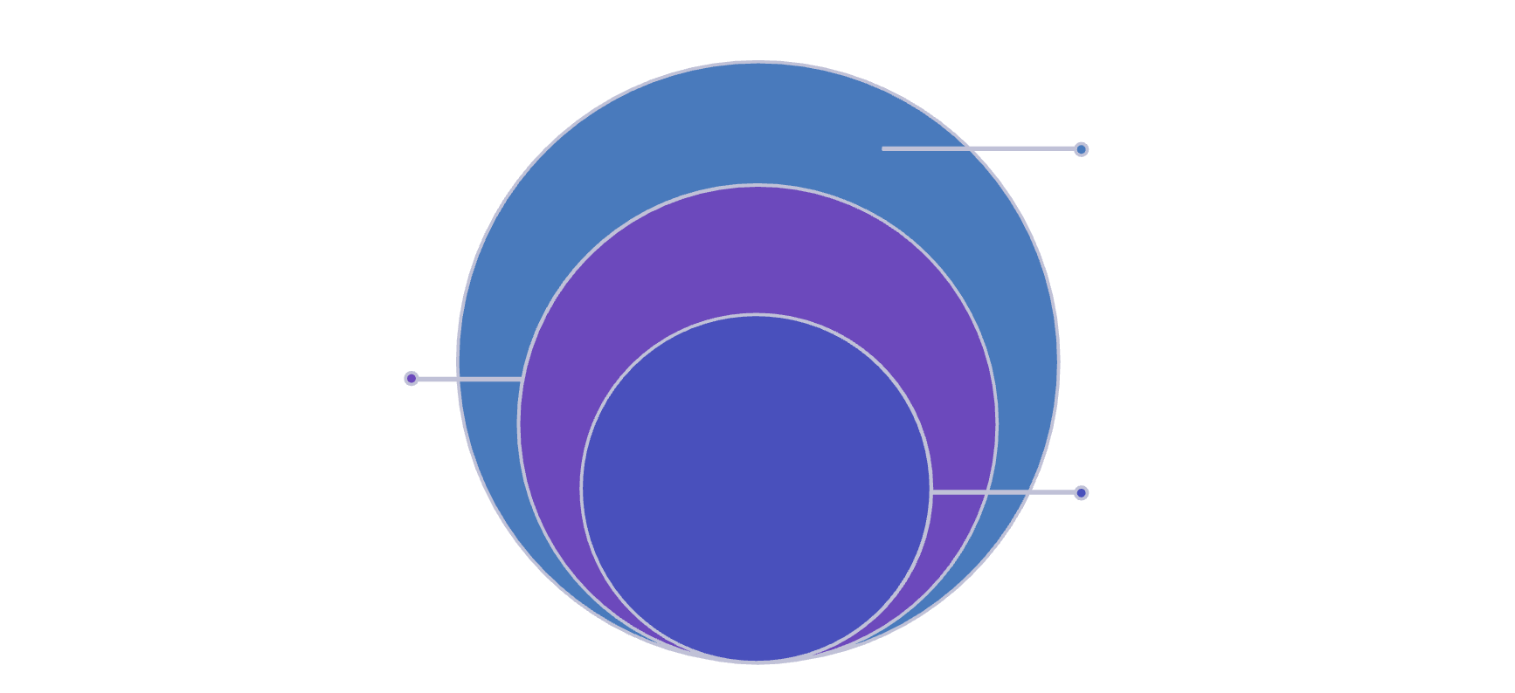
Cultural Audits, Mapping & Gap Analysis
Practices & Culture
Formal guidelines and visible behaviors.
Norms & Beliefs
Shared values and unwritten rules.
Deeply held, often unstated beliefs.
Unconscious Assumptions
Understanding "Where we are" → "Where we want to be" → "How to get there"

Slide 14
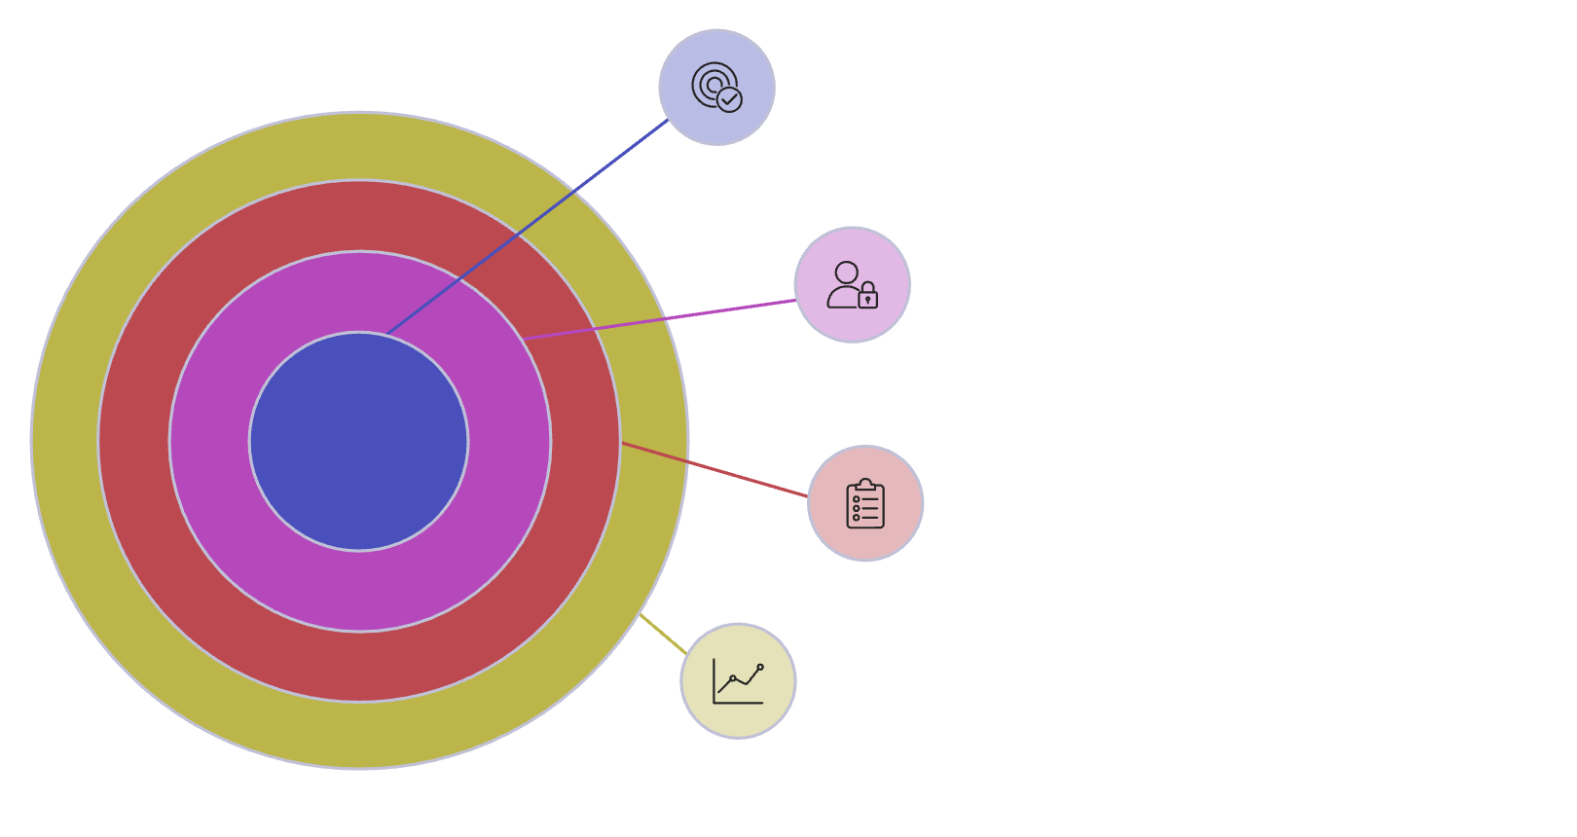
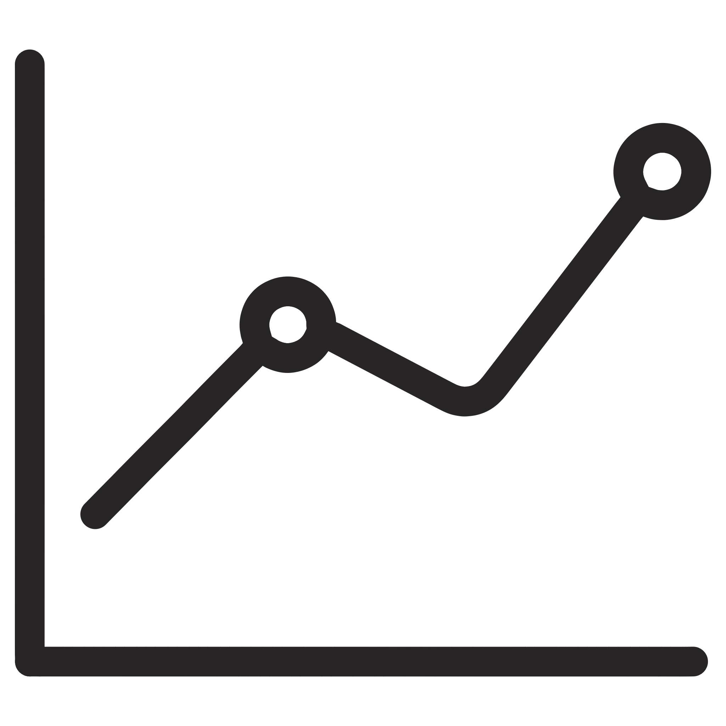
Why Cultural Audits Matter
Core Purpose
Understand organizational values.
Employee Experience
Assess engagement and inclusion.
Processes & Policies
Identify gaps and misalignments.
Business Impact
Link culture to performance.
A cultural audit is a systematic review of organizational culture—the values, behaviors, assumptions, and artifacts that define how work gets done.
The Business Impact
Culture deeply influences how change initiatives—especially digital transformation—succeed or fail
Alignment between culture and strategy drives engagement, innovation, and performance
Mapping and gap analysis help visualize current culture versus desired culture, identifying critical misalignments that can derail strategic initiatives.
Without systematic assessment, organizations risk culture drift and wasted change effort

Slide 15
Core Concepts Defined
Cultural Audit
A "health-check" of organizational culture, examining daily behaviors, beliefs, and norms, not just stated mission.
Core Concepts Defined
Cultural Mapping
Visually representing current and desired culture using frameworks to identify strengths, weaknesses, and growth opportunities.
Gap Analysis
Comparing current and desired culture to identify specific differences and determine necessary changes for alignment.

Slide 16
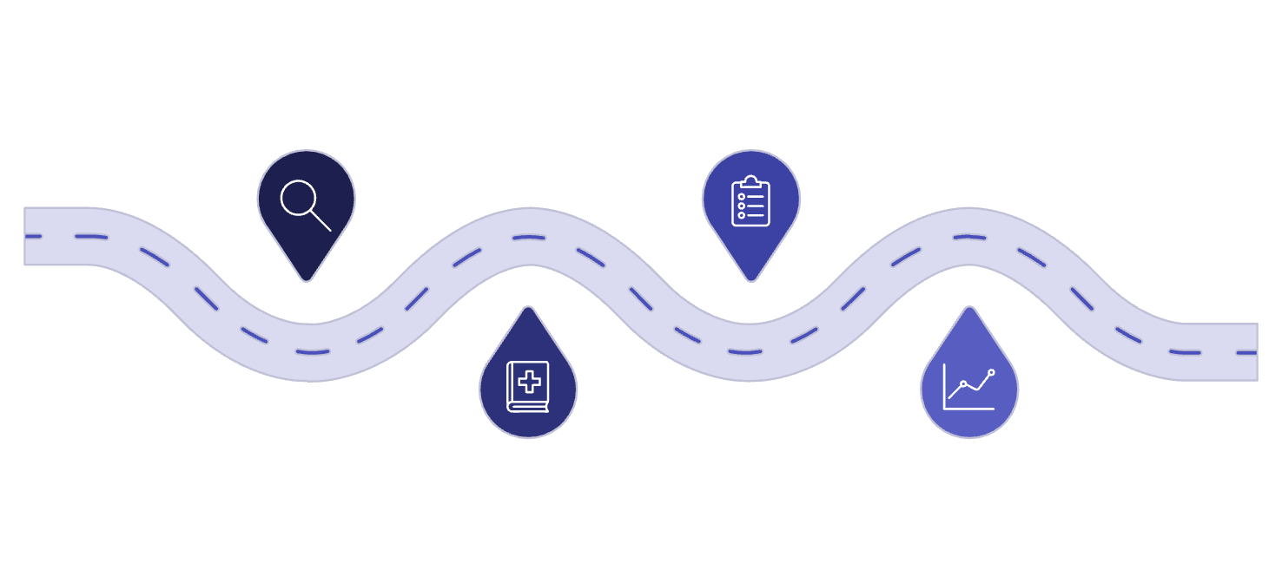
The Cultural Audit Process
Discovery
Gather data and stakeholder input
Action Plan
Define initiatives and priorities
Diagnosis
Measure
Analyze culture gaps and strengths
Track progress and adjust
01
02
Define Scope & Objectives
Identify Cultural Levers
Decide which parts of the company to look at. Set clear goals and pick the most important culture traits for success.
Identify daily activities, leader behaviors, and company practices that shape the culture.
03
04
Collect Comprehensive Data
Analyze Alignment
Use surveys, interviews, group discussions, and observations. Also review company documents and processes.
See if current behaviors and practices align with desired values. Look for what fits and what doesn't.
05
06
Present Findings
Embed Into Action
Write down strengths, weaknesses, differences, and key themes. Make it clear and easy for leaders to understand.
Use these findings to create culture maps, identify gaps, and start new projects with clear, measurable results.

Slide 17
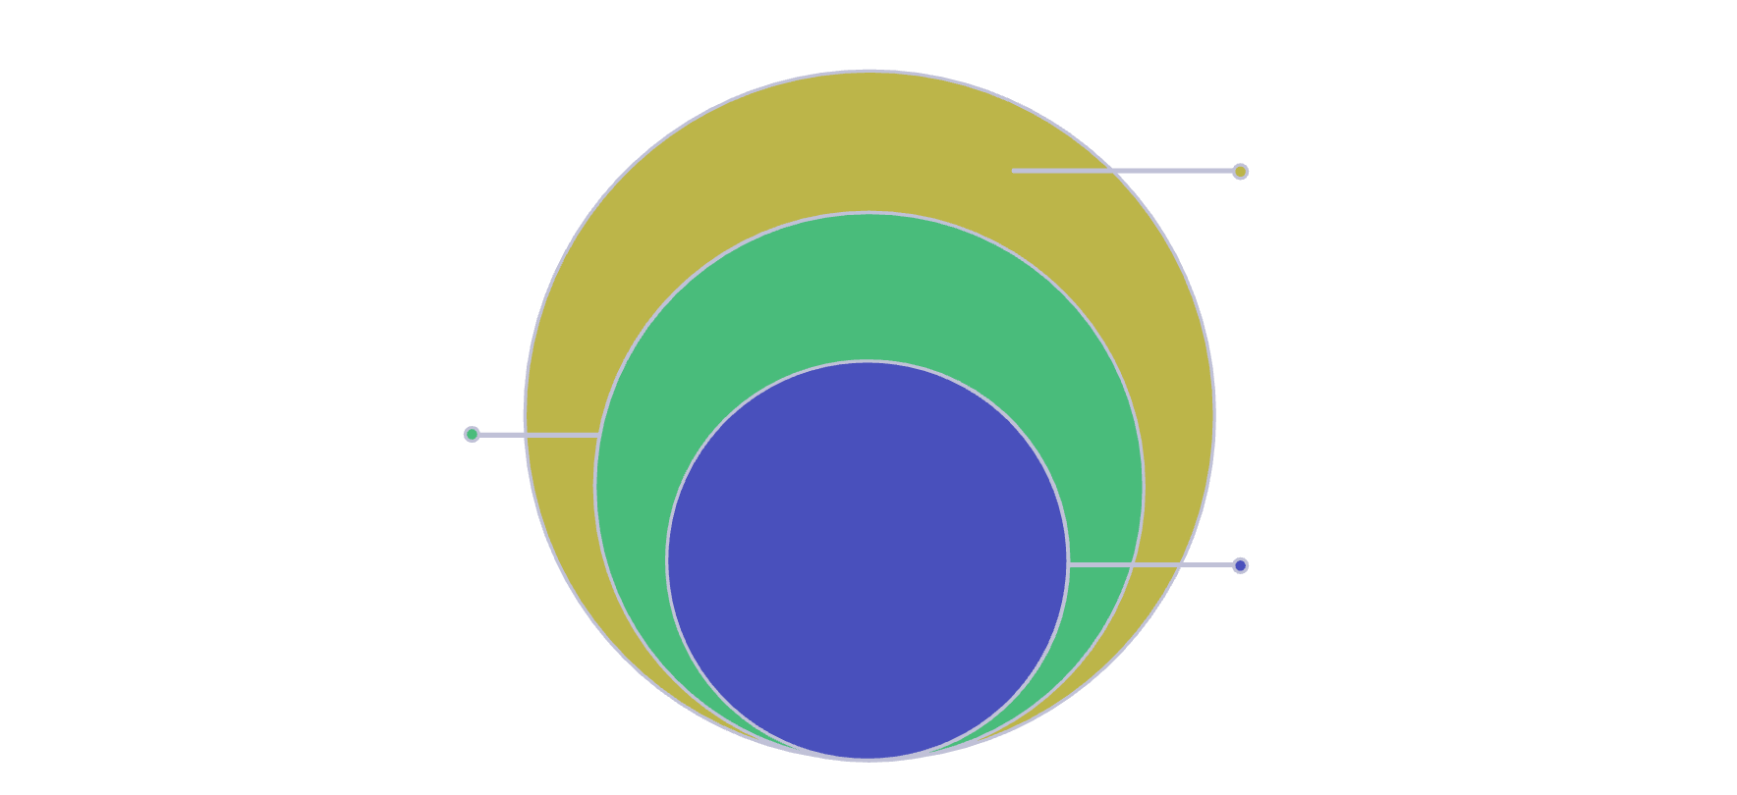
Visualizing Culture Through Mapping
Signals
Symbols, language, spaces, and measurable behaviors
Drivers
Leadership, rituals, stories, and policies shaping culture
Culture Map
Visual representation of organizational values and behaviors
Mapping Techniques
Leverage proven frameworks like the Competing Values Framework to categorize culture types
Create radar charts showing current versus desired cultural profiles
Use quadrant maps to position the organization across key dimensions
Develop heat maps highlighting areas of strong or weak alignment
These visual tools transform intangible culture into tangible, actionable insights that drive strategic decision-making.

Slide 18




Understanding the Cultural Gap
Desired Culture
The values, behaviors, and norms needed to support strategy and achieve the organization's future state vision.
Current Culture
How people actually behave, make decisions, and interact—the real "way things get done around here" versus stated ideals.
The Gap
The critical difference requiring targeted interventions, with larger gaps demanding stronger change initiatives.
Common Gap Drivers: Leadership inconsistency, mixed messages from different levels, competing subcultures, reward systems that contradict stated values.

Slide 19
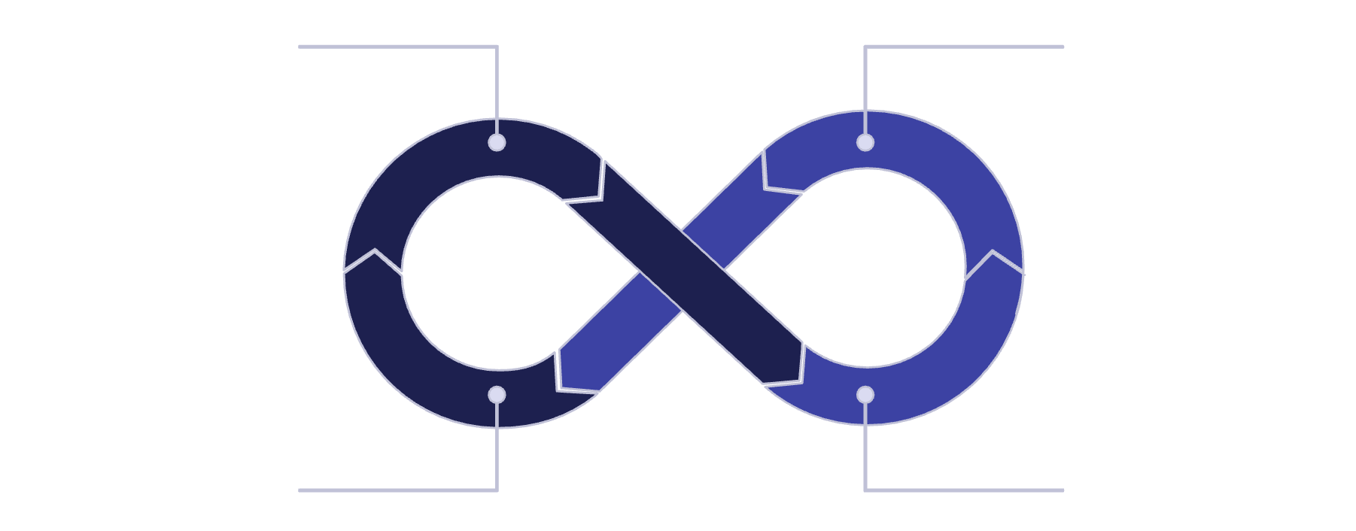
Conducting Effective Gap Analysis
Observable Outcomes
Documented Gaps
Root Causes
Process Inefficiencies
Deploy Assessment Instruments
Gather Qualitative Insights
Use validated surveys or custom instruments to gather quantitative data on current versus desired culture across multiple dimensions and organizational levels.
Conduct in-depth interviews, facilitate focus groups, and observe actual behaviors to uncover deeper patterns, unspoken norms, and underlying assumptions.
Analyze & Prioritize
Translate Into Action
Identify key areas of misalignment between stated values, actual behaviors, and organizational systems. Prioritize the gaps with greatest strategic impact.
Convert findings into specific change themes with clear implications. Example: "We aspire to innovation, but our reward system punishes risk-taking."

Slide 20
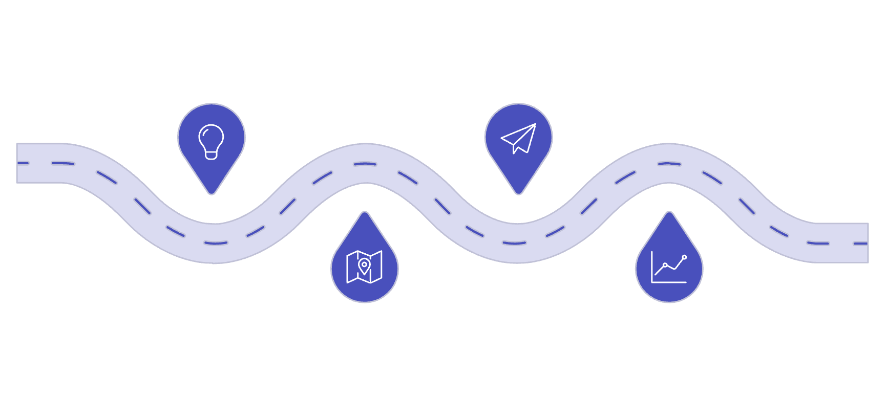




From Insight to Action
Insight
Execution
Gather data and uncover patterns
Implement initiatives and workflows
Strategy
Measure
Translate findings into a clear plan
Track outcomes and refine approach
Making Culture Change Stick
Gap analysis is only valuable when it leads to concrete action. Successful organizations translate cultural insights into specific interventions:
Redesign reward and recognition systems to reinforce desired behaviors
Develop leadership capabilities aligned with target culture
Modify decision-making processes and governance structures
Update hiring criteria and onboarding programs
Implement new rituals and practices that embody desired values
Monitor progress through regular pulse checks and adjust strategies based on real-time feedback from across the organization.

